Slide 1
COMP 4351 – Network Administration Fall 2016
Chapter 5
Network Cabling
Notes:
Chapter 5
Network Cabling

Slide 2
Objectives
Explain basic data transmission concepts, including signaling, data modulation, multiplexing, bandwidth, baseband, and broadband
Describe the physical characteristics and Ethernet standards of coaxial cable, STP, UTP, and fiber-optic media
Compare the benefits and limitations of different networking media
Notes:
Objectives
Explain basic data transmission concepts, including signaling, data modulation, multiplexing, bandwidth, baseband, and broadband
Describe the physical characteristics and Ethernet standards of coaxial cable, STP, UTP, and fiber-optic media
Compare the benefits and limitations of different networking media

Slide 3
Objectives
Explore the connectors, converters, and couplers for each cabling type
Examine common cable problems and differentiate between various tools for troubleshooting those problems
Notes:
Objectives
Explore the connectors, converters, and couplers for each cabling type
Examine common cable problems and differentiate between various tools for troubleshooting those problems

Slide 4
Transmission Basics
Transmission techniques in use on today’s network are complex and varied
This section covers fundamental characteristics that define today’s data transmission
Notes:
Transmission Basics
Transmission techniques in use on today’s network are complex and varied
This section covers fundamental characteristics that define today’s data transmission

Slide 5
Analog Signaling
Analog signals - vary infinitely and continuously
Appear as a wavy line when graphed over time
Analog signals are characterized by four properties:
Amplitude
Measure of strength at given point in time
Frequency
Number of times amplitude cycles over fixed time
Wavelength
Distance between one peak and the next
Phase
Progress of wave over time compared to a fixed point
Notes:
Analog Signaling
Analog signals - vary infinitely and continuously
Appear as a wavy line when graphed over time
Analog signals are characterized by four properties:
Amplitude
Measure of strength at given point in time
Frequency
Number of times amplitude cycles over fixed time
Wavelength
Distance between one peak and the next
Phase
Progress of wave over time compared to a fixed point

Slide 6
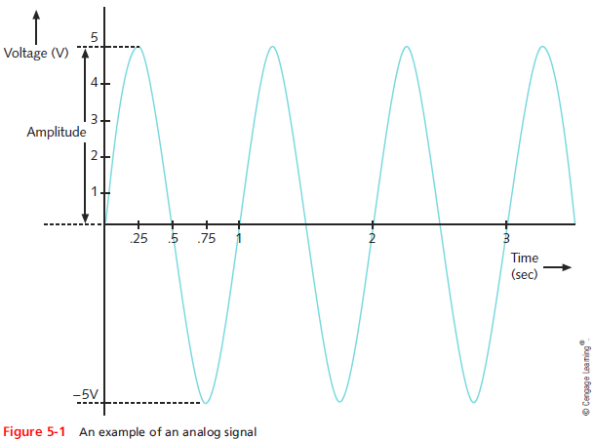
Analog Signaling
Notes:
Analog Signaling

Slide 7
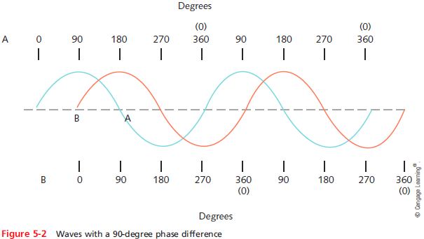
Analog Signaling
Drawback of analog signals
Varied and imprecise voltage
Susceptible to transmission flaws
Notes:
Analog Signaling
Drawback of analog signals
Varied and imprecise voltage
Susceptible to transmission flaws

Slide 8
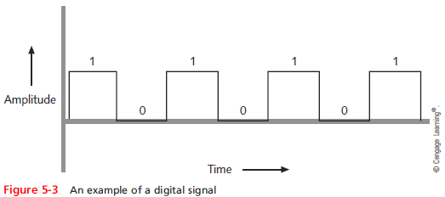
Digital Signaling
Digital signals
Pulses of voltages
Positive voltage represents a 1
Zero voltage represents a 0
Notes:
Digital Signaling
Digital signals
Pulses of voltages
Positive voltage represents a 1
Zero voltage represents a 0

Slide 9
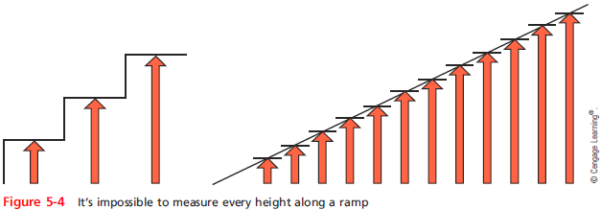
Digital Signaling
Notes:
Digital Signaling

Slide 10
Data Modulation
Data relies on digital transmission
Network connection may handle only analog signals
Modem
Accomplishes this translation
Modulator/demodulator
Data modulation
Technology modifying analog signals into digital signals and vice versa
Make analog signals suitable for carrying data over a communication path
Notes:
Data Modulation
Data relies on digital transmission
Network connection may handle only analog signals
Modem
Accomplishes this translation
Modulator/demodulator
Data modulation
Technology modifying analog signals into digital signals and vice versa
Make analog signals suitable for carrying data over a communication path

Slide 11
Data Modulation
Carrier wave
Combined with another analog signal
Produces unique signal
Transmitted from one node to another
Preset properties
Purpose: convey information
Information wave (data wave)
Added to carrier wave
Modifies one carrier wave property
Notes:
Data Modulation
Carrier wave
Combined with another analog signal
Produces unique signal
Transmitted from one node to another
Preset properties
Purpose: convey information
Information wave (data wave)
Added to carrier wave
Modifies one carrier wave property

Slide 12
Data Modulation
Frequency modulation
Carrier frequency modified by application of data signal
Amplitude modulation
Carrier signal amplitude modified by application of data signal
Digital subscriber line (DSL)
Also makes use of modulation
Notes:
Data Modulation
Frequency modulation
Carrier frequency modified by application of data signal
Amplitude modulation
Carrier signal amplitude modified by application of data signal
Digital subscriber line (DSL)
Also makes use of modulation

Slide 13
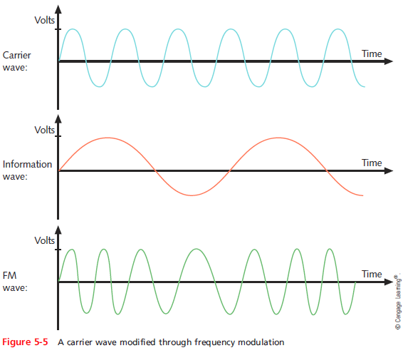
Data Modulation
Notes:
Data Modulation

Slide 14
Baseband and Broadband
Baseband transmission
Digital signals that are carried on a single channel
Requires exclusive use of wire’s capacity
Example: Ethernet
Broadband transmission
Multiple transmissions share a single media
Transmission sharing the same media rely on multiplexing to manage multiple signals
Example: Cable TV and cable Internet
Notes:
Baseband and Broadband
Baseband transmission
Digital signals that are carried on a single channel
Requires exclusive use of wire’s capacity
Example: Ethernet
Broadband transmission
Multiple transmissions share a single media
Transmission sharing the same media rely on multiplexing to manage multiple signals
Example: Cable TV and cable Internet

Slide 15
Multiplexing
Multiplexing
A form of transmission that allows multiple signals to travel simultaneously over one medium
Subchannels
Logical multiple smaller channels
Multiplexer (mux)
Combines many channel signals
Required at the transmitting end of the channel
Demultiplexer (demux)
Separates the combined signals
Notes:
Multiplexing
Multiplexing
A form of transmission that allows multiple signals to travel simultaneously over one medium
Subchannels
Logical multiple smaller channels
Multiplexer (mux)
Combines many channel signals
Required at the transmitting end of the channel
Demultiplexer (demux)
Separates the combined signals

Slide 16
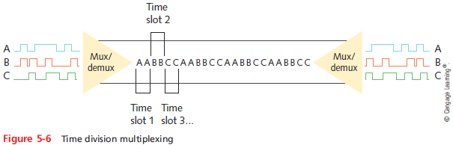
Multiplexing
TDM (Time division multiplexing)
Divides channel into multiple time intervals
Notes:
Multiplexing
TDM (Time division multiplexing)
Divides channel into multiple time intervals

Slide 17
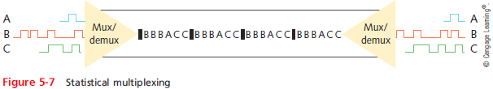
Multiplexing
Statistical multiplexing
Transmitter assigns slots to nodes
According to priority, need
More efficient than TDM
Notes:
Multiplexing
Statistical multiplexing
Transmitter assigns slots to nodes
According to priority, need
More efficient than TDM

Slide 18
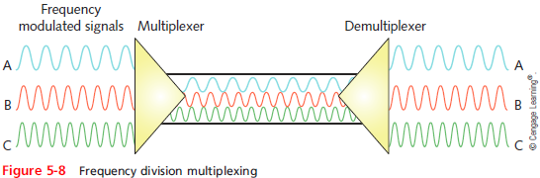
Multiplexing
FDM (Frequency Division Multiplexing)
Unique frequency band for each communications subchannel
Cellular telephone transmission
DSL Internet access
Notes:
Multiplexing
FDM (Frequency Division Multiplexing)
Unique frequency band for each communications subchannel
Cellular telephone transmission
DSL Internet access

Slide 19
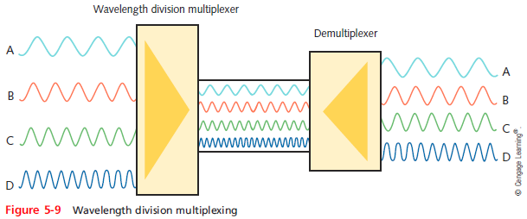
Multiplexing
WDM (Wavelength Division Multiplexing)
One fiber-optic connection
Carries multiple light signals simultaneously
Notes:
Multiplexing
WDM (Wavelength Division Multiplexing)
One fiber-optic connection
Carries multiple light signals simultaneously

Slide 20
Multiplexing
DWDM (Dense Wavelength Division Multiplexing)
Used on most modern fiber-optic networks
Extraordinary capacity
Typically used on high-bandwidth or long-distance WAN links
CWDM (Coarse Wavelength Division Multiplexing)
Developed after DWDM in an effort to lower the cost of the transceiver equipment needed
Channels are spaced more widely apart across entire frequency band
Notes:
Multiplexing
DWDM (Dense Wavelength Division Multiplexing)
Used on most modern fiber-optic networks
Extraordinary capacity
Typically used on high-bandwidth or long-distance WAN links
CWDM (Coarse Wavelength Division Multiplexing)
Developed after DWDM in an effort to lower the cost of the transceiver equipment needed
Channels are spaced more widely apart across entire frequency band

Slide 21
Throughput and Bandwidth
Throughput
Amount of data transmitted during given time period
Also called payload rate or effective data rate
Expressed as bits transmitted per second
Bandwidth (strict definition)
Difference between highest and lowest frequencies medium can transmit
Range of frequencies
Both are commonly expressed as bits transmitted per second, called bit rate
Notes:
Throughput and Bandwidth
Throughput
Amount of data transmitted during given time period
Also called payload rate or effective data rate
Expressed as bits transmitted per second
Bandwidth (strict definition)
Difference between highest and lowest frequencies medium can transmit
Range of frequencies
Both are commonly expressed as bits transmitted per second, called bit rate

Slide 22
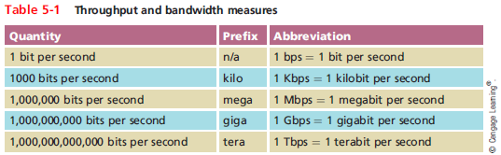
Throughput and Bandwidth
Notes:
Throughput and Bandwidth

Slide 23
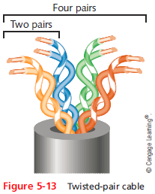
Twisted-Pair Cable
Color-coded insulated copper wire pairs
0.4 to 0.8 mm diameter
Encased in a plastic sheath
Every two wires are twisted
together
Notes:
Twisted-Pair Cable
Color-coded insulated copper wire pairs
0.4 to 0.8 mm diameter
Encased in a plastic sheath
Every two wires are twisted
together

Slide 24
Twisted-Pair Cable
More wire pair twists per foot
More resistance to cross talk
Higher-quality
More expensive
Twist ratio
Twists per meter or foot
High twist ratio
Greater attenuation
Notes:
Twisted-Pair Cable
More wire pair twists per foot
More resistance to cross talk
Higher-quality
More expensive
Twist ratio
Twists per meter or foot
High twist ratio
Greater attenuation

Slide 25
Twisted-Pair Cable
Hundreds of different designs
Twist ratio, number of wire pairs, copper grade, shielding type, shielding materials
1 to 4200 wire pairs possible
Wiring standard specification
TIA/EIA 568
Most common twisted pair types
Category (cat) 3, 5, 5e, 6, 6a, 7
CAT 5e or higher used in modern LANs
Notes:
Twisted-Pair Cable
Hundreds of different designs
Twist ratio, number of wire pairs, copper grade, shielding type, shielding materials
1 to 4200 wire pairs possible
Wiring standard specification
TIA/EIA 568
Most common twisted pair types
Category (cat) 3, 5, 5e, 6, 6a, 7
CAT 5e or higher used in modern LANs

Slide 26
Twisted-Pair Cable
Advantages
Relatively inexpensive
Flexible
Easy installation
Spans significant distance before requiring repeater
Accommodates several different topologies
Two categories
Shielded twisted pair (STP)
Unshielded twisted pair (UTP)
Notes:
Twisted-Pair Cable
Advantages
Relatively inexpensive
Flexible
Easy installation
Spans significant distance before requiring repeater
Accommodates several different topologies
Two categories
Shielded twisted pair (STP)
Unshielded twisted pair (UTP)

Slide 27
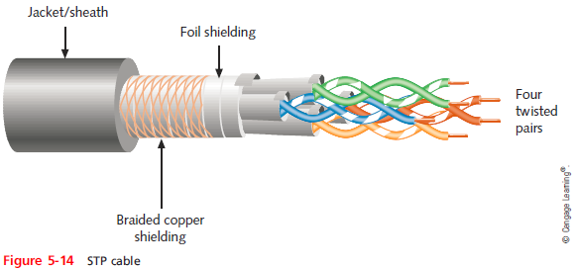
STP (Shielded Twisted Pair)
Individually insulated
Surrounded by metallic substance shielding (foil)
Barrier to external electromagnetic forces
Contains electrical energy of signals inside
May be grounded
Notes:
STP (Shielded Twisted Pair)
Individually insulated
Surrounded by metallic substance shielding (foil)
Barrier to external electromagnetic forces
Contains electrical energy of signals inside
May be grounded

Slide 28
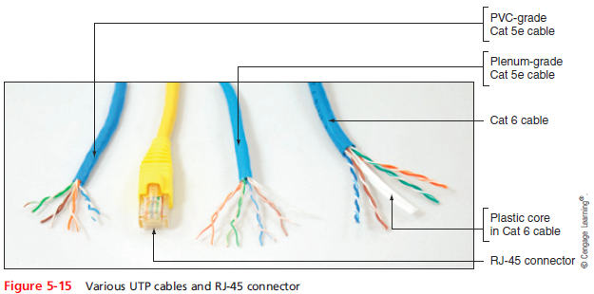
UTP (Unshielded Twisted Pair)
One or more insulated wire pairs
Encased in plastic sheath
No additional shielding
Less expensive, less noise resistance
Notes:
UTP (Unshielded Twisted Pair)
One or more insulated wire pairs
Encased in plastic sheath
No additional shielding
Less expensive, less noise resistance

Slide 29
Comparing STP and UTP
Throughput
STP and UTP can transmit the same rates
Cost
STP and UTP vary in cost
Connector
STP and UTP use Registered Jack 45
Noise immunity
STP more noise resistant
Size and scalability
Maximum segment length for both: 100 meters
Notes:
Comparing STP and UTP
Throughput
STP and UTP can transmit the same rates
Cost
STP and UTP vary in cost
Connector
STP and UTP use Registered Jack 45
Noise immunity
STP more noise resistant
Size and scalability
Maximum segment length for both: 100 meters

Slide 30
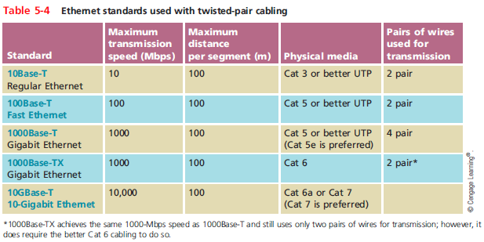
Ethernet Standards for Twisted-Pair Cabling
Notes:
Ethernet Standards for Twisted-Pair Cabling

Slide 31
Cable Pinouts
Proper cable termination is a requirement for two nodes on a network to communicate
TIA/EIA specifies two methods of inserting wires into RJ-45 plugs
TIA/EIA 568A
TIA/EIA 568B
No functional difference between the two standards
Just make sure you use the same standard on every RJ-45 plug and jack
Notes:
Cable Pinouts
Proper cable termination is a requirement for two nodes on a network to communicate
TIA/EIA specifies two methods of inserting wires into RJ-45 plugs
TIA/EIA 568A
TIA/EIA 568B
No functional difference between the two standards
Just make sure you use the same standard on every RJ-45 plug and jack

Slide 32
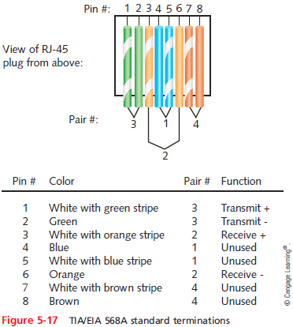
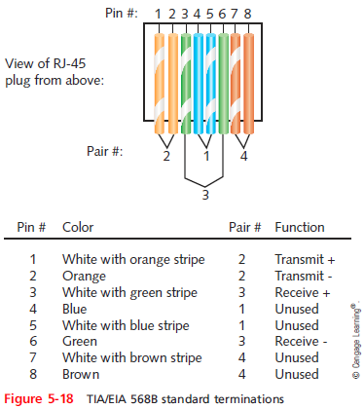
Cable Pinouts
Notes:
Cable Pinouts

Slide 33
Cable Pinouts
Straight-through cable
Terminate RJ-45 plugs at both ends identically
Crossover cable
Transmit and receive wires on one end reversed
Rollover cable
All wires are reversed
Terminations are a mirror image of each other
Also called Yost cables or Cisco console cables
Used to connect a computer to the console port of a router
Notes:
Cable Pinouts
Straight-through cable
Terminate RJ-45 plugs at both ends identically
Crossover cable
Transmit and receive wires on one end reversed
Rollover cable
All wires are reversed
Terminations are a mirror image of each other
Also called Yost cables or Cisco console cables
Used to connect a computer to the console port of a router

Slide 34
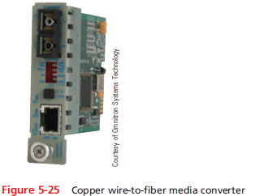
Copper Connectors and Couplers
Media converter
Enables networks or segments running on different media to interconnect and exchange signals
Coupler
Passes data through a homogenous connection without any modification
Notes:
Copper Connectors and Couplers
Media converter
Enables networks or segments running on different media to interconnect and exchange signals
Coupler
Passes data through a homogenous connection without any modification

Slide 35
PoE (Power over Ethernet)
PoE - IEEE 802.3af standard which specifies a method for supplying electrical power over twisted-pair Ethernet connections
Amount of power provided:
15.4 watts for standard PoE devices
25.5 watts for newer PoE+ devices (802.3at standard)
PoE standard specifies two types of devices:
PSE (power sourcing equipment)
PD (powered devices)
Notes:
PoE (Power over Ethernet)
PoE - IEEE 802.3af standard which specifies a method for supplying electrical power over twisted-pair Ethernet connections
Amount of power provided:
15.4 watts for standard PoE devices
25.5 watts for newer PoE+ devices (802.3at standard)
PoE standard specifies two types of devices:
PSE (power sourcing equipment)
PD (powered devices)

Slide 36
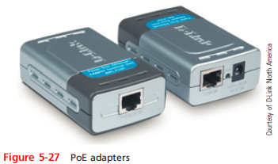
PoE (Power over Ethernet)
The IEEE standard requires that a PSE device first determine whether a node is PoE-capable before attempting to supply it with power
On networks that demand PoE but don’t have PoE-capable equipment, you can add PoE adapters
Notes:
PoE (Power over Ethernet)
The IEEE standard requires that a PSE device first determine whether a node is PoE-capable before attempting to supply it with power
On networks that demand PoE but don’t have PoE-capable equipment, you can add PoE adapters

Slide 37
Fiber-Optic Cable
Fiber-optic cable (fiber)
One or more glass or plastic fibers at its center (core)
Data transmission
Pulsing light sent from laser or light-emitting diode (LED) through central fibers
Cladding
Layer of glass or plastic surrounding fibers
Different density from glass or plastic in strands
Reflects light back to core
Allows fiber to bend
Notes:
Fiber-Optic Cable
Fiber-optic cable (fiber)
One or more glass or plastic fibers at its center (core)
Data transmission
Pulsing light sent from laser or light-emitting diode (LED) through central fibers
Cladding
Layer of glass or plastic surrounding fibers
Different density from glass or plastic in strands
Reflects light back to core
Allows fiber to bend

Slide 38
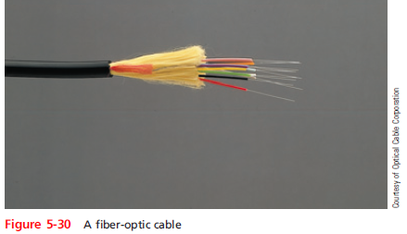
Fiber-Optic Cable
Plastic buffer outside cladding
Protects cladding and core
Opaque to absorb escaping light
Surrounded by Kevlar (polymeric fiber) strands
Plastic sheath covers Kevlar strands
Notes:
Fiber-Optic Cable
Plastic buffer outside cladding
Protects cladding and core
Opaque to absorb escaping light
Surrounded by Kevlar (polymeric fiber) strands
Plastic sheath covers Kevlar strands

Slide 39
Fiber-Optic Cable
Benefits over copper cabling
Extremely high throughput
Very high noise resistance
Excellent security
Able to carry signals for longer distances
Industry standard for high-speed networking
Drawbacks
More expensive than twisted pair cable
Requires special equipment to splice
Notes:
Fiber-Optic Cable
Benefits over copper cabling
Extremely high throughput
Very high noise resistance
Excellent security
Able to carry signals for longer distances
Industry standard for high-speed networking
Drawbacks
More expensive than twisted pair cable
Requires special equipment to splice

Slide 40
Fiber-Optic Cable
Throughput
Proven reliable in transmitting data at rates that can reach 100 gigabits per second per channel
Cost
Most expensive transmission medium
Noise immunity
Unaffected by EMI
Size and scalability
Segment lengths vary from 150 to 40,000 meters
Depends on the light’s wavelength and type of cable
Notes:
Fiber-Optic Cable
Throughput
Proven reliable in transmitting data at rates that can reach 100 gigabits per second per channel
Cost
Most expensive transmission medium
Noise immunity
Unaffected by EMI
Size and scalability
Segment lengths vary from 150 to 40,000 meters
Depends on the light’s wavelength and type of cable

Slide 41
SMF (Single Mode Fiber)
Consists of narrow core (8-10 microns in diameter)
Laser-generated light travels over one path
Little reflection
Light does not disperse as signal travels
Can carry signals many miles:
Before repeating is required
Rarely used for shorter connections
Due to cost
The Internet backbone depends on SMF
Notes:
SMF (Single Mode Fiber)
Consists of narrow core (8-10 microns in diameter)
Laser-generated light travels over one path
Little reflection
Light does not disperse as signal travels
Can carry signals many miles:
Before repeating is required
Rarely used for shorter connections
Due to cost
The Internet backbone depends on SMF

Slide 42
MMF (Multimode Fiber)
Contains a core with a larger diameter than single mode fiber
Common sizes: 50 or 62.5 microns
Laser or LED generated light pulses travel at different angles
Greater attenuation than single-mode fiber
Common uses
Cables connecting router to a switch
Cables connecting server on network backbone
Notes:
MMF (Multimode Fiber)
Contains a core with a larger diameter than single mode fiber
Common sizes: 50 or 62.5 microns
Laser or LED generated light pulses travel at different angles
Greater attenuation than single-mode fiber
Common uses
Cables connecting router to a switch
Cables connecting server on network backbone

Slide 43
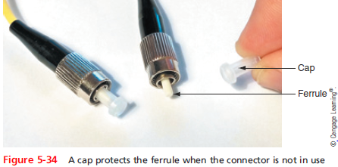
Fiber Connectors and Couplers
MMF connectors
Classified by the number of fibers
SMF connectors
Classified by size and shape of the ferrule
Ferrule - the extended tip of a connector that makes contact with the receptacle in the jack
Notes:
Fiber Connectors and Couplers
MMF connectors
Classified by the number of fibers
SMF connectors
Classified by size and shape of the ferrule
Ferrule - the extended tip of a connector that makes contact with the receptacle in the jack

Slide 44
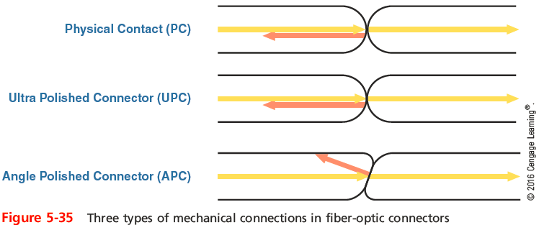
Fiber Connectors and Couplers
Shapes and polishes used by SMF ferrules to reduce back reflection:
Physical Contact (PC)
Ultra Polished Connector (UPC)
Angle Polished Connector (APC)
Notes:
Fiber Connectors and Couplers
Shapes and polishes used by SMF ferrules to reduce back reflection:
Physical Contact (PC)
Ultra Polished Connector (UPC)
Angle Polished Connector (APC)

Slide 45
Fiber Connectors and Couplers
SMF connectors are typically available with a 1.25-mm ferrule or a 2.5-mm ferrule
Most common 1.25-mm connector is the LC
Three 2.5-mm connectors are the SC, ST, and FC
Most common MMF connector is the MT-RJ
Existing fiber networks might use ST or SC connectors
LC and MT-RJ are used on the very latest fiber-optic technology
Notes:
Fiber Connectors and Couplers
SMF connectors are typically available with a 1.25-mm ferrule or a 2.5-mm ferrule
Most common 1.25-mm connector is the LC
Three 2.5-mm connectors are the SC, ST, and FC
Most common MMF connector is the MT-RJ
Existing fiber networks might use ST or SC connectors
LC and MT-RJ are used on the very latest fiber-optic technology

Slide 46
Fiber-Optic Converters and Modular Interfaces
Converters are required to connect multimode fiber networks to single-mode fiber networks
Also fiber- and copper-based parts of a network
Bidirectional converter accepts the signal from one part of the network, then regenerates the signal and sends it to the next part of the network
GBIC - a standard type of modular interface designed for Gigabit Ethernet connections
May contain RJ-45 or fiber-optic cable ports
Notes:
Fiber-Optic Converters and Modular Interfaces
Converters are required to connect multimode fiber networks to single-mode fiber networks
Also fiber- and copper-based parts of a network
Bidirectional converter accepts the signal from one part of the network, then regenerates the signal and sends it to the next part of the network
GBIC - a standard type of modular interface designed for Gigabit Ethernet connections
May contain RJ-45 or fiber-optic cable ports

Slide 47
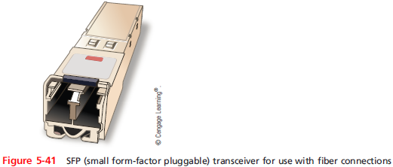
Fiber-Optic Converters and Modular Interfaces
SFP (small form-factor pluggable) transceivers
Provide the same function as a GBIC, but allow more ports per inch
Sometimes known as mini GBICs or SFP GBICs
Two types: XFP and SFP+
Notes:
Fiber-Optic Converters and Modular Interfaces
SFP (small form-factor pluggable) transceivers
Provide the same function as a GBIC, but allow more ports per inch
Sometimes known as mini GBICs or SFP GBICs
Two types: XFP and SFP+

Slide 48
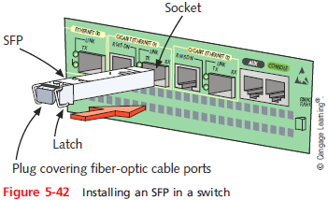
Fiber-Optic Converters and Modular Interfaces
Installing a GBIC or SFP
Slide the transceiver into a socket on the back of the connectivity device
Most SFPs come with a tab or latch system and keyed so that they will slide into the socket when aligned properly
Notes:
Fiber-Optic Converters and Modular Interfaces
Installing a GBIC or SFP
Slide the transceiver into a socket on the back of the connectivity device
Most SFPs come with a tab or latch system and keyed so that they will slide into the socket when aligned properly

Slide 49
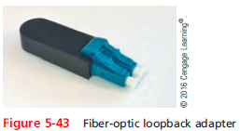
Fiber-Optic Converters and Modular Interfaces
Loopback adapter
A helpful tool when testing an SFP’s functionality or checking for a mismatch
Notes:
Fiber-Optic Converters and Modular Interfaces
Loopback adapter
A helpful tool when testing an SFP’s functionality or checking for a mismatch

Slide 50
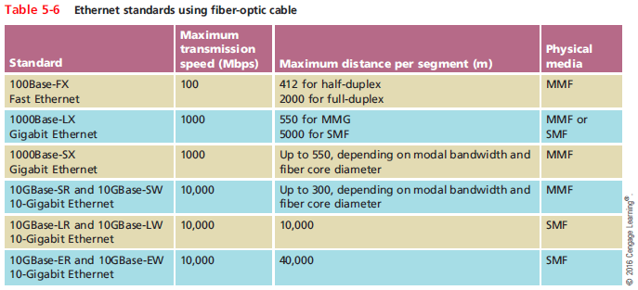
Ethernet Standards for Fiber-Optic Cable
Notes:
Ethernet Standards for Fiber-Optic Cable

Slide 51
Transmission Flaws
Noise
Any undesirable influence degrading or distorting signal
Types of noise
EMI (electromagnetic interference)
Example: radio frequency interference
Cross-talk
Signal on one wire infringes on adjacent wire signal
Alien cross-talk occurs between two cables
Near end cross-talk (NEXT) occurs near source
Far end cross-talk (FEXT) occurs at the far end
Notes:
Transmission Flaws
Noise
Any undesirable influence degrading or distorting signal
Types of noise
EMI (electromagnetic interference)
Example: radio frequency interference
Cross-talk
Signal on one wire infringes on adjacent wire signal
Alien cross-talk occurs between two cables
Near end cross-talk (NEXT) occurs near source
Far end cross-talk (FEXT) occurs at the far end

Slide 52
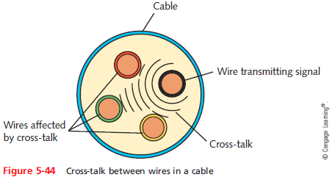
Transmission Flaws
Notes:
Transmission Flaws

Slide 53
Transmission Flaws
Attenuation
Loss of signal’s strength as it travels away from source
Two ways analog and digital signals are boosted:
Amplifier - increases the voltage, or strength, of signals
Can also boot the noise that has accumulated in the signal
Repeater - regenerates a digital signal in its original form
Without noise previously accumulated
Notes:
Transmission Flaws
Attenuation
Loss of signal’s strength as it travels away from source
Two ways analog and digital signals are boosted:
Amplifier - increases the voltage, or strength, of signals
Can also boot the noise that has accumulated in the signal
Repeater - regenerates a digital signal in its original form
Without noise previously accumulated

Slide 54
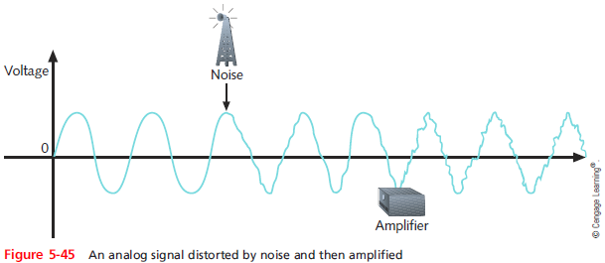
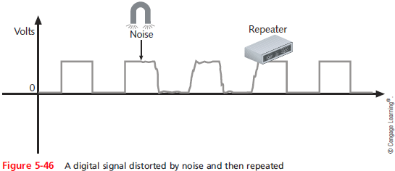
Transmission Flaws
Notes:
Transmission Flaws

Slide 55
Transmission Flaws
Latency
Delay between signal transmission and receipt
May cause network transmission errors
Latency causes
Cable length
Intervening connectivity device
Round trip time (RTT)
Time for packet to go from sender to receiver, then back from receiver to sender
Notes:
Transmission Flaws
Latency
Delay between signal transmission and receipt
May cause network transmission errors
Latency causes
Cable length
Intervening connectivity device
Round trip time (RTT)
Time for packet to go from sender to receiver, then back from receiver to sender

Slide 56
Transmission Flaws
Common Fiber Cable Problems:
Fiber type mismatch
More of a fiber core mismatch
Even same-mode cables can be mismatched if the cores have different widths
Wavelength mismatch
SMF, MMF, and POF (Plastic Optical Fiber) use different wavelengths
Dirty connectors
Signal loss and other errors can start to cause problems
Notes:
Transmission Flaws
Common Fiber Cable Problems:
Fiber type mismatch
More of a fiber core mismatch
Even same-mode cables can be mismatched if the cores have different widths
Wavelength mismatch
SMF, MMF, and POF (Plastic Optical Fiber) use different wavelengths
Dirty connectors
Signal loss and other errors can start to cause problems

Slide 57
Troubleshooting Tools
Tone generator (toner)
Small electronic device
Issues signal on wire pair
Tone locator (probe)
Emits tone when electrical activity detected
Probe kit or toner probe
Generator and locator combination
Testing requires trial and error
Used to determine where wired pair terminates
Not used to determine cable characteristics
Notes:
Troubleshooting Tools
Tone generator (toner)
Small electronic device
Issues signal on wire pair
Tone locator (probe)
Emits tone when electrical activity detected
Probe kit or toner probe
Generator and locator combination
Testing requires trial and error
Used to determine where wired pair terminates
Not used to determine cable characteristics

Slide 58
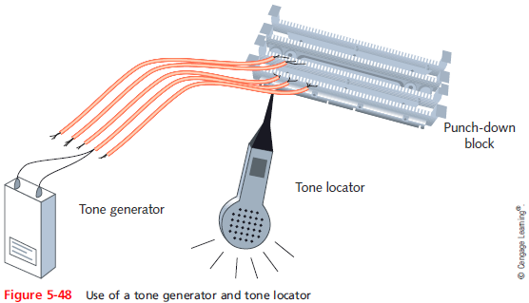
Troubleshooting Tools
Notes:
Troubleshooting Tools

Slide 59
Troubleshooting Tools
Multimeter
Measures electric circuit characteristics
Resistance, voltage, and impedance
Use a multimeter to do the following:
Measure voltage to verify cable is conducting electricity
Check for the presence of noise
Verify the amount of resistance is appropriate
Test for short or open circuits in the wire
Notes:
Troubleshooting Tools
Multimeter
Measures electric circuit characteristics
Resistance, voltage, and impedance
Use a multimeter to do the following:
Measure voltage to verify cable is conducting electricity
Check for the presence of noise
Verify the amount of resistance is appropriate
Test for short or open circuits in the wire

Slide 60
Troubleshooting Tools
Cable continuity testers (cable testers)
Tests whether cable carries signal to destination
Copper-based cable tester
Consists of two parts
Base unit generates voltage
Remote unit detects voltage
Series of lights, audible tone
Used to signal pass/fail
Notes:
Troubleshooting Tools
Cable continuity testers (cable testers)
Tests whether cable carries signal to destination
Copper-based cable tester
Consists of two parts
Base unit generates voltage
Remote unit detects voltage
Series of lights, audible tone
Used to signal pass/fail

Slide 61
Troubleshooting Tools
Some continuity testers verify UTP, STP wires paired correctly
Not shorted, exposed, crossed
Fiber optic continuity tester
Issues light pulses on fiber
Determines whether pulses reach other end
Test all cables to ensure meeting network’s required standards
Homemade or purchased
Offer convenience: portable, lightweight, low cost
Notes:
Troubleshooting Tools
Some continuity testers verify UTP, STP wires paired correctly
Not shorted, exposed, crossed
Fiber optic continuity tester
Issues light pulses on fiber
Determines whether pulses reach other end
Test all cables to ensure meeting network’s required standards
Homemade or purchased
Offer convenience: portable, lightweight, low cost

Slide 62
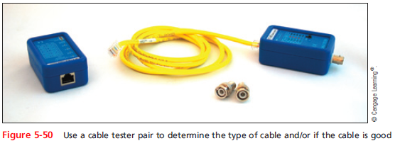
Troubleshooting Tools
Notes:
Troubleshooting Tools

Slide 63
Troubleshooting Tools
Cable performance tester, line tester, or certifier
Performs similarly to continuity testers but can be used to:
Measure distance to a connectivity device, termination point, or cable fault
Measure attenuation
Measure near end cross-talk
Measure termination resistance and impedance
Issue pass/fail ratings for Cat 3-7 standards
Store and print results or save to a computer database
Graphically depict attenuation and cross-talk
Notes:
Troubleshooting Tools
Cable performance tester, line tester, or certifier
Performs similarly to continuity testers but can be used to:
Measure distance to a connectivity device, termination point, or cable fault
Measure attenuation
Measure near end cross-talk
Measure termination resistance and impedance
Issue pass/fail ratings for Cat 3-7 standards
Store and print results or save to a computer database
Graphically depict attenuation and cross-talk
Cable performance tester, line tester, or certifier
Performs similarly to continuity testers but can be used to:
Measure distance to a connectivity device, termination point, or cable fault
Measure attenuation
Measure near end cross-talk
Measure termination resistance and impedance
Issue pass/fail ratings for Cat 3-7 standards
Store and print results or save to a computer database
Graphically depict attenuation and cross-talk

Slide 64
Troubleshooting Tools
TDR (time domain reflectometer)
Issue signal, measures signal bounce back
Indicates distance between nodes
Indicates whether terminators properly installed, functional
OTDRs (optical time domain reflectometers)
Measure fiber length
Determine faulty splice locations, breaks, connectors, bends and measure attenuation over cable
Expensive
Notes:
Troubleshooting Tools
TDR (time domain reflectometer)
Issue signal, measures signal bounce back
Indicates distance between nodes
Indicates whether terminators properly installed, functional
OTDRs (optical time domain reflectometers)
Measure fiber length
Determine faulty splice locations, breaks, connectors, bends and measure attenuation over cable
Expensive

Slide 65
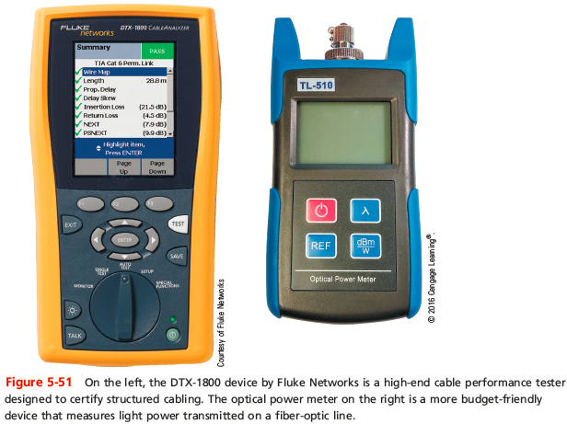
Troubleshooting Tools
Notes:
Troubleshooting Tools

Slide 66
Troubleshooting Tools
OPM (Optical Power Meter)
Also called a laser power meter or a light meter
Measures the amount of light power transmitted on a fiber-optic line
Must be calibrated precisely following highly accurate optical power standards
Surrounding room temperature, connection type, and the skill of the technician all affect the final test results
Notes:
Troubleshooting Tools
OPM (Optical Power Meter)
Also called a laser power meter or a light meter
Measures the amount of light power transmitted on a fiber-optic line
Must be calibrated precisely following highly accurate optical power standards
Surrounding room temperature, connection type, and the skill of the technician all affect the final test results

Slide 67
Summary
Computers generate and interpret data signals as electrical current where voltage is finitely measured as on or off and interpreted as binary data
A channel is a distinct communication path between nodes and may be separated logically or physically
A baseband transmission is the only transmission on the media, in broadband, multiple transmissions share a single media
Broadband transmission require multiplexing
Throughput is the measure of how much data is transmitted during a given time period
Notes:
Summary
Computers generate and interpret data signals as electrical current where voltage is finitely measured as on or off and interpreted as binary data
A channel is a distinct communication path between nodes and may be separated logically or physically
A baseband transmission is the only transmission on the media, in broadband, multiple transmissions share a single media
Broadband transmission require multiplexing
Throughput is the measure of how much data is transmitted during a given time period

Slide 68
Summary
Coaxial cable was the foundation for Ethernet networks in the 1980s
Twisted-pair cable consists of color-coded pairs of insulated copper wires that are twisted in pairs
STP cable consists of twisted-pair wires that are not only individually insulated, but also surrounded by a shielding made of a metallic substance
UTP does not contain additional shielding
TIA/EIA has specified two different methods of inserting wires into RJ-45 plugs: 568A and 568B
Notes:
Summary
Coaxial cable was the foundation for Ethernet networks in the 1980s
Twisted-pair cable consists of color-coded pairs of insulated copper wires that are twisted in pairs
STP cable consists of twisted-pair wires that are not only individually insulated, but also surrounded by a shielding made of a metallic substance
UTP does not contain additional shielding
TIA/EIA has specified two different methods of inserting wires into RJ-45 plugs: 568A and 568B

Slide 69
Summary
A rollover cable uses a reverse image of the pinout of the other end of a cable
Fiber-optic cable contains one or more several glass or plastic fibers at it core
SMF accommodates the highest bandwidths and longest distances of all network transmission media
MMF contains a core with a larger diameter
Fiber-optic cabling is the best medium for delivering high throughput
A common source of noise is EMI
Notes:
Summary
A rollover cable uses a reverse image of the pinout of the other end of a cable
Fiber-optic cable contains one or more several glass or plastic fibers at it core
SMF accommodates the highest bandwidths and longest distances of all network transmission media
MMF contains a core with a larger diameter
Fiber-optic cabling is the best medium for delivering high throughput
A common source of noise is EMI

Slide 70
Summary
Cross-talk occurs when a signal traveling on one wire or cable infringes on the signal traveling on an adjacent wire or cable
Attenuation is the loss of a signal’s strength
Latency is the delay between the instant data leaves the source and when it arrives at its destination
A multimeter is a simple instrument that measures resistance, voltage, impedance, and other characteristics
Tools used to test cables: cable checkers, continuity testers, cable testers, and light meters (for fiber)
Notes:
Summary
Cross-talk occurs when a signal traveling on one wire or cable infringes on the signal traveling on an adjacent wire or cable
Attenuation is the loss of a signal’s strength
Latency is the delay between the instant data leaves the source and when it arrives at its destination
A multimeter is a simple instrument that measures resistance, voltage, impedance, and other characteristics
Tools used to test cables: cable checkers, continuity testers, cable testers, and light meters (for fiber)

